Slide 1
Employee Scheduling
By Ya-Ling Su
Weiyu Peng
Venkata Praveen Naradasu

Slide 2


Problem Statement
Several on campus employers like Armark,O’Connel Center have huge student employee base
Their demand for workers, across multiple locations and events vary
Scheduling Student employees is eating up most of my schedule
We are exhausting our employees during closing shifts
HR
Store Manager

Slide 3


Student Employee perspective
Huge diversity in availability
Some shifts are exhaustive because often understaffed
Making last minute requests is a big NO because HR is not comfortable with it
They scheduled me again during my class timings
Barista
Catering worker

Slide 4
Objective
We want to design a mechanism to satisfy two sides (the company side and the employee). How to fill the company operation demand and also the employee can pick their willing to work hours at the same time.

Slide 5
Objectives and Constraints
Assist HR in decision making with respect to future hiring process
Make accommodating last minute changes to schedule a easy process
Meet diverse constraints like Weekly working limits,class schedules
Maintain employee satisfaction
Minimize number of workers overall needed

Slide 6
Sounds Cool!
Problem

Slide 7
Methodologies
2

Slide 8
A Greedy approach by rewarding hired worker
Mimics general scheduling process by preferring the first scheduled workers for later shifts in week
Cons:
Employes can rig the system by providing more availability in initial time slots
Not a global minima of employees required for the company.
Mars

Slide 9
Linear Programming approach
Meets the current objective of minimizing total workers needed (Can be tested for a different objective)
Employees won't be able to benefit by Gaming the system

Slide 10
Data
Constraints
Synthetic Data :
Employee availability
Store demand
Minimum and maximum working hours (if possible)
No variance in skillset
Meet store’s fluctuating demand all the time.(Considered a constant demand per slot as of now)
No Employee should be scheduled outside his availability
Employees meet minimum(if possible) and maximum working hours

Slide 11
Greedy Approach
Linear Programming
Problem
By checking 80 employees availability, we needed only 33 employees satisfying all the constraints
For 80 employees availability,we can hire only 22 workers subjecting to all the constraints

Slide 12
Data generation
We used a random normal distribution (mean=3.5,std=4, range (0,6)) to generate workdays and work time shifts, and combined these two to generate work time preference data for candidate workers.
In this project, each worker has 10 preference work time shifts with the day, so all the candidates will have their preference working shifts list and there are no two identical time shifts in everyone's preference list.

Slide 13
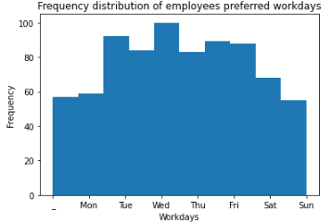
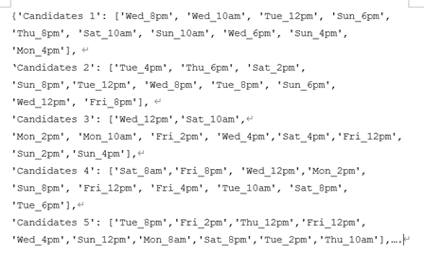
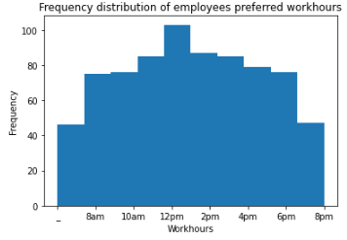
Data generation
Example of preference working list
The area to the left of the scale represents the number of samples for the corresponding scale.

Slide 14
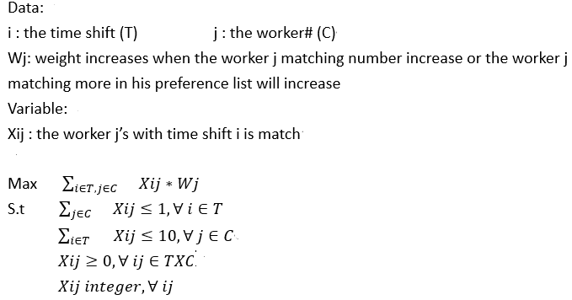
Model 1 (Greedy approach)
1.Each time a worker is matched for each time slot that does not meet the minimum number of workers (if the time slot is still in the worker's preference list)
2.Each time, the number of remaining requirements for each work period is updated, as well as the list of preferences for each worker (remove the matched time shift from the list), and repeat the step one.
3.Stop the iteration until there are no new matches that satisfy the condition.

Slide 15
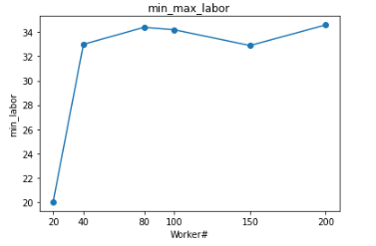
Test results
In the graph, we can see when the worker = 80 will have the max labor after that even the worker number increase but for the min labor decrease than before. Also, after we set the worker greater than 80, the time shift always satisfies, there don’t have any left.
Min_Max_Labor

Slide 16
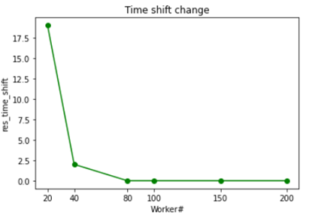
Test results
In the graph, we can see when the worker = 80 will have the max labor after that even the worker number increase but for the min labor decrease than before. Also, after we set the worker greater than 80, the time shift always satisfies, there don’t have any left.
The Rest of Work Time shift

Slide 17
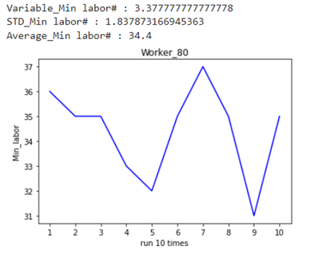
Test results
Following these tables and the above information, we have a conclusion when the worker= 80 will have the max labor demand and satisfy all the work time shifts, so we run for 10 times to see the different data.
The Rest of Work Time shift

Slide 18
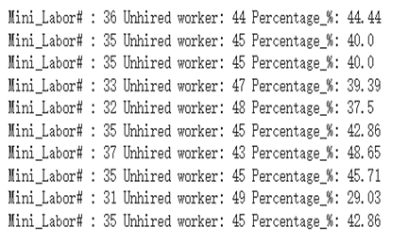
Test results
Following these tables and the above information, we have a conclusion when the worker= 80 will have the max labor demand and satisfy all the work time shifts, so we run for 10 times to see the different data.
Run 10 times data of 80 worker

Slide 19
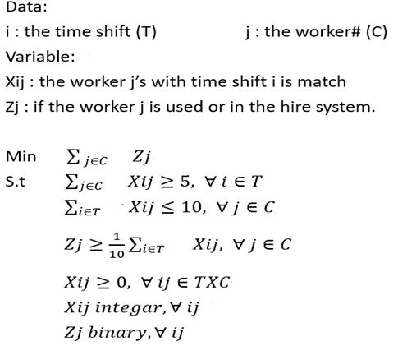
Model 2(Mixed integer linear programming)
The mechanism of the objective is to min the labor number in the matching system.
First, we set the two variables as X_{ij} is an integer and Z_{j} is binary.
Constraint1 is for each time shift at least have 5 people to satisfy the work period demand.
Constraint2 is for each candidate can't exceed the 10 preference list.
Constraint3 is if the candidates i who participated in the match were assigned a value of 1, and those who were not hired were assigned a value of 0.
Notes:
we used a simpler way to do it that set a mixed integer programming matching model, just using the gurobi package to build the model without the iteration method to obtain the objective of min labor.
The result of the model_2, It can be easier to get the number of time shifts that each candidate can be selected and all the time shifts fill the restraint (5 people) without using any greedy way or iteration method.

Slide 20
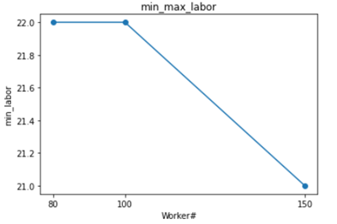
Test results
In the graph, we can see when the worker= 80 will have the max labor after that even the worker number increase but for the min labor decrease than before. Also, synchronization affects the unhired worker number as the right chart. The unhired number increase when we set the worker number increase.
Min_Max_Labor
Notes:
The final objective is clear, and must strictly meet the constraints of the objective function.Following these tables and the above information, we find that when the worker = 80 will have the max labor demand and satisfy all the work time shifts

Slide 21
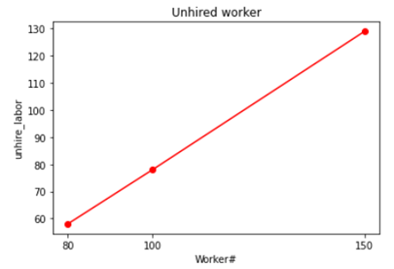
Test results
In the graph, we can see when the worker= 80 will have the max labor after that even the worker number increase but for the min labor decrease than before. Also, synchronization affects the unhired worker number as the right chart. The unhired number increase when we set the worker number increase.
Unhired Worker Number
Notes:
The final objective is clear, and must strictly meet the constraints of the objective function.Following these tables and the above information, we find that when the worker = 80 will have the max labor demand and satisfy all the work time shifts

Slide 22
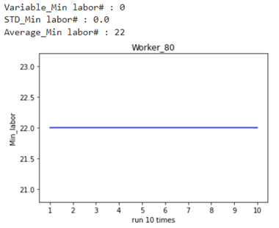
Test results
Following these tables and the above information, we have a conclusion when the worker= 80 will have the max labor demand. Therefore, we run 10 times to see if there are any changes under the model_2.
Run 10 times data of 80 worker
Notes:
You can see that the min labor, the number of un-hire workers do not change and the percentage of not satisfied with the min 10 hours of candidates is 0 which means when the candidates enter the hire system, there are not any workers fulfilling the min 10 working hour. Also, we calculate that the average of the min labor is 22 because running 10 times of min labor is the same which causes the standard deviation and the variable equal to 0.

Slide 23
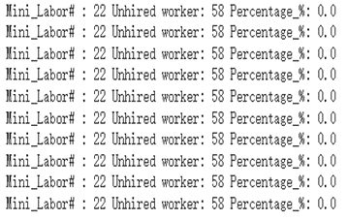
Test results
Following these tables and the above information, we have a conclusion when the worker= 80 will have the max labor demand. Therefore, we run 10 times to see if there are any changes under the model_2.
The Rest of Work Time shift
Notes:
You can see that the min labor, the number of un-hire workers do not change and the percentage of not satisfied with the min 10 hours of candidates is 0 which means when the candidates enter the hire system, there are not any workers fulfilling the min 10 working hour. Also, we calculate that the average of the min labor is 22 because running 10 times of min labor is the same which causes the standard deviation and the variable equal to 0.

Slide 24
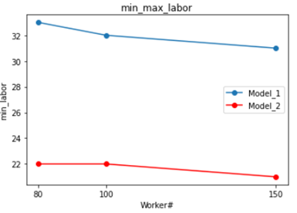
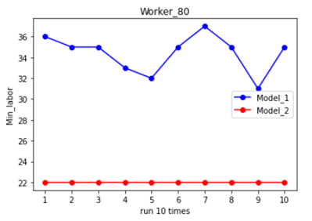
Conclusion
Min_Max_Labor
Run 10 times between two models
Model_2 is the more appropriate model than model_1 for our project

Slide 25
Conclusion
For model_1:
The quantities of supply and demand are very close to each other.
A small sample size
The final objective is unclear (it does not need to fully meet the final expected goal and constraint)
For model_2:
The quantities of supply should exceed the the quantities of demand.
A huge sample size
The final objective is clear, and must strictly meet the constraints of the objective function.

Slide 26
Additional features:
Under varying pay rates (varying skill sets)
Varying Demand of Employees per slot over peak hours

Slide 27
Thanks
We would love to hear your questions and feedback!

Slide 28
Alternative Resources
Stephen O’Connel center’s scheduling mechanism ‘Team Xpress’

